Slide 1
Data Structures
ICT-1211
Information and Communication Technology
Lecture-16
Date: //2024

Slide 2
Stacks, Queues, Recursion

Slide 3
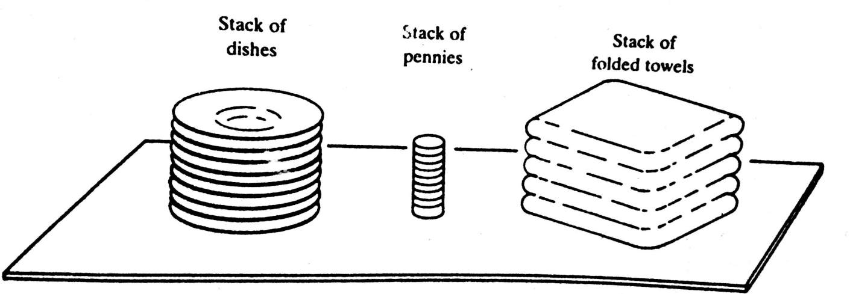
STACKS: Introduction
A stack is a linear structure in which items may be added or removed only at one ends
Stacks are also called Last-in-First-out (LIFO) list.
Other names:
    Piles
    Push-down lists.
Although the stack may be a very restricted type of data structure, it has many important applications in computer science.

Slide 4
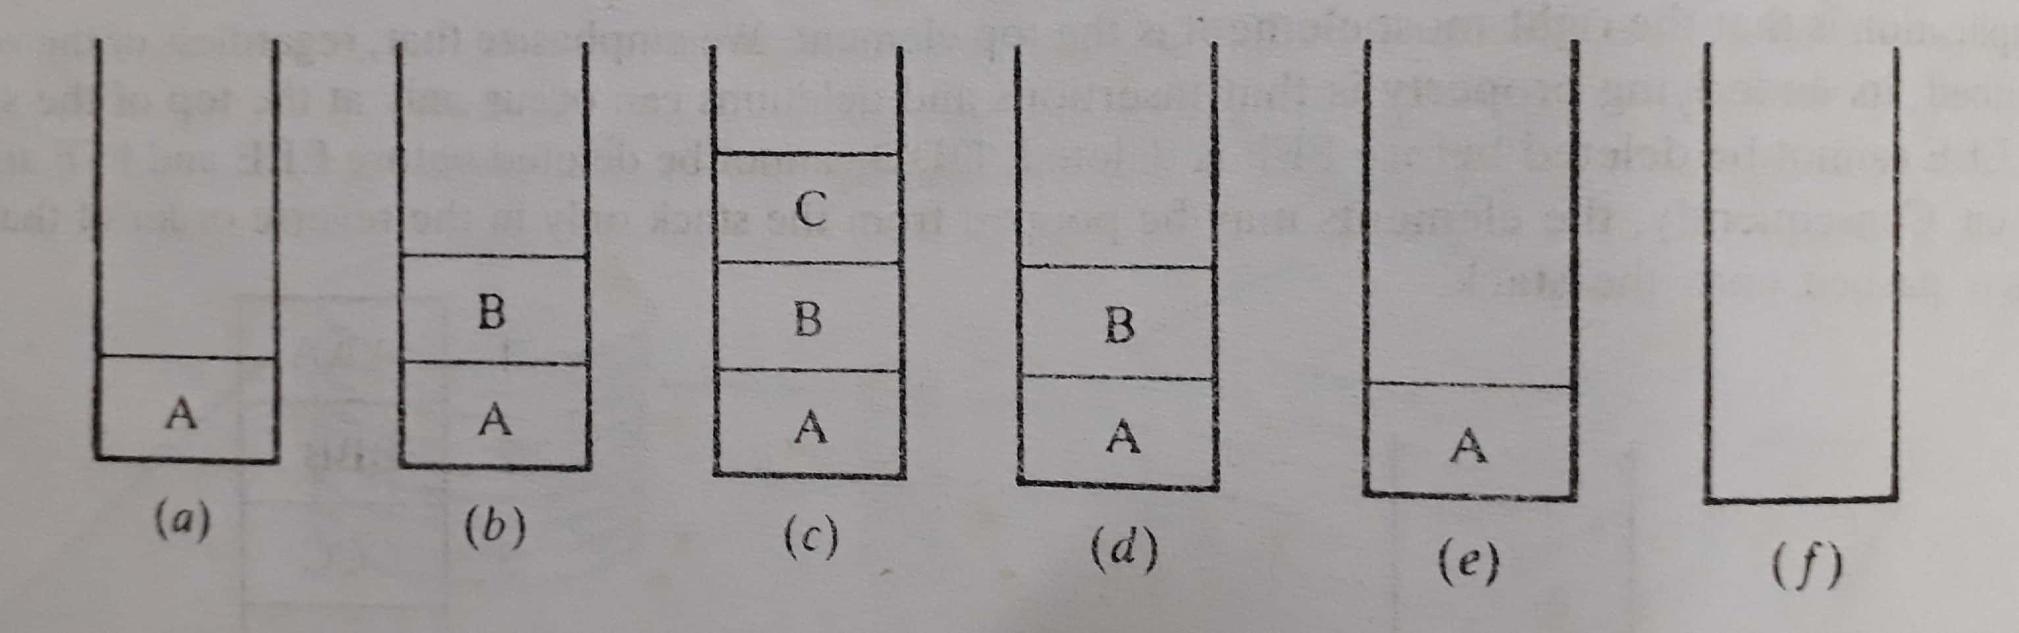
STACKS: Dealing Postponed Decisions
Stacks are frequently used to indicate the order of the processing of data when certain steps of the processing must be postponed until other conditions are fulfilled.

Slide 5
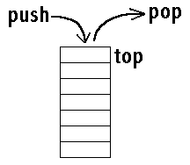
STACKS: Special Terminology
Special terminology is used for two basic operations associated with stacks:
“Push”-used to insert an element into a stack
“Pop”-used to delete an element from a stack.

Slide 6
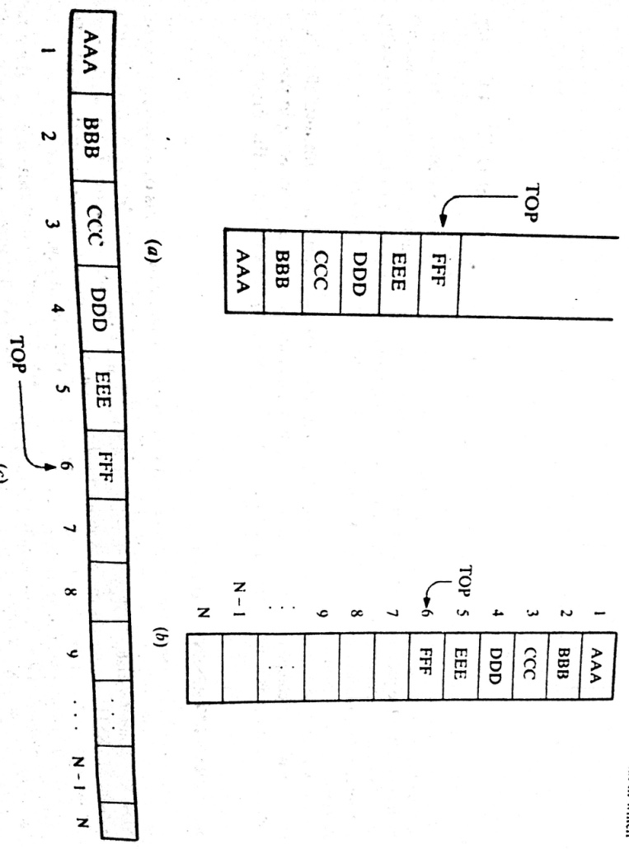
STACKS: Push Example
Suppose the following 6 elements are pushed, in order, onto an empty stack:
AAA, BBB, CCC, DDD, EEE, FFF
Diagram of Stack

Slide 7
STACKS: Array Representation
Stack may be represented in the computer in various ways,
      usually by means of a one-way list, or
      A linear array
Usually Stacks will be maintained by…...
    A linear array, STACK,(main lists)
    A pointer variable, TOP, (contains the locations of the top element of the stack)
    A variable MAXSTK, (gives the maximum number of elements that can be held by the stack)
The condition TOP=0 or TOP=NULL of a STACK indicates…..?
EMPTY

Slide 8
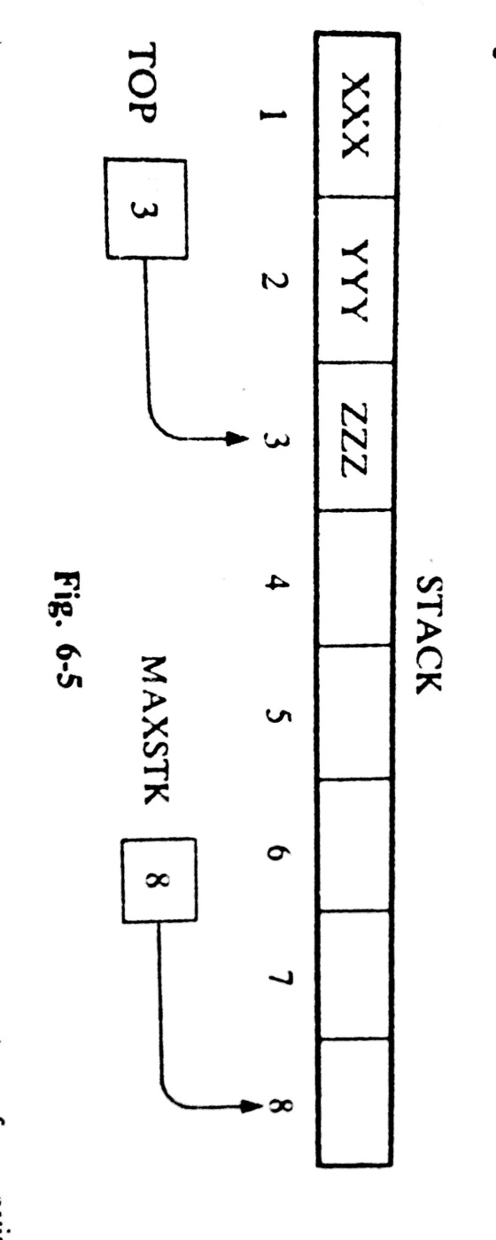
STACKS: Array Representation Example
Present Status: TOP=3;
MAXSTK=8;
There is room for 5 more items in the stack
Future Implementation:
Pushing an item onto a stack
Popping an item from a stack

Slide 9
STACKS: Pushing Algorithm
PUSH (STACK, TOP, MAXSTK, ITEM)
Step 1. [Stack already filled?]
If TOP=MAXSTK, then print: OVERFLOW, and Return.
Step 2. Set TOP=TOP+1. [Increase TOP by 1.]
Step 3. Set STACK[TOP]:=ITEM. [Insert ITEM in new TOP position]
Step 4. Return
1. Since TOP=3, go to Step 2
2. TOP=3+1=4
3. STACK [TOP]=STACK[4]= WWW
4. Return

Slide 10
STACKS: Popping Algorithm
POP (STACK, TOP, ITEM)
Step 1. [Stack has an item to be removed?]
If TOP=0, then print: Underflow, and Return.
Step 2. Set ITEM= STACK[TOP] [Assign TOP element to ITEM.]
Step 3. Set TOP:= TOP-1. [Decreases TOP by 1]
Step 4. Return
1. Since TOP=3, go to Step 2
2. ITEM=ZZZ.
3. TOP=3-1=2.
4. Return.

Slide 11
STACKS:
PUSH
1. Since TOP=3, go to Step 2
2. TOP=3+1=4
3. STACK [TOP]=STACK[4]= WWW
4. Return
POP
1. Since TOP=3, go to Step 2
2. ITEM=ZZZ.
3. TOP=3-1=2.
4. Return.
TOP is changed before the insertion in PUSH, whereas
TOP is changed after the deletion in POP

Slide 12
STACKS: Arithmetic Expressions;
Let Q be an arithmetic expression involving constants and operation.
Q: 2 ↑3+5*2 ↑2-12/6, we have to find the value of Q
Q may have different levels of precedence in its binary operations.
We assume the following three levels of precedence for the usual FIVE binary operations.
  Highest: Exponential (↑)
  Next Highest: Multiplication (*) and division(/)
  Lowest: Addition (+) and Subtraction(-)
Thus, we obtain after exponentiations (8+5*4-12/6)
After, multiplication and division (8+20-2)
After. Addition and subtraction , 26

Slide 13
STACKS: Polish Notation
For most common arithmetic operations:
A+B, C-D, E*F, G/H (infix notation)
Polish notation refers to the notation in which the operator symbol is placed before its two operands.
For example: +AB, -CD, *EF, /GH
Instant Exercise: (Infix expression to polish notation)
(A+B)*C = ?
A+(B*C) = ?
= [+AB]*C=?
= A+[*BC]=?
= *+ABC
= +A*BC

Slide 14
STACKS: Polish Notation
(A+B)/(C-D) = ?
= [+AB]/[-CD] = ?
= /+AB-CD
The fundamental property of polish notation is that the order in which the operations are to be performed is completely determined by
    The positions of the operators, and
    Operands in the expression.
One never needs parentheses when writing expressions in polish notation.

Slide 15
STACKS: Reverse Polish Notation
Reverse Polish Notation refers to the analogous notation in which the operator symbol is placed after its two operands:
AB+, CD-, EF*, GH/
This notation is frequently called postfix notation
One never needs parentheses to determine the order of the operations in any arithmetic expression in postfix notation

Slide 16
STACKS: Evaluation of Postfix Expression
P: 5, 6, 2, +, *, 12, 4, /, -
Symbol Scanned | STACK
(1) 5
5
(2) 6
5, 6
(3) 2
5, 6, 2
(4) +
5, 8
(5) *
40
(6) 12
40, 12
(7) 4
40, 12, 4
(8) /
40, 3
(9) -
37
(10) )

Slide 17
Thank you……

